Slide 1
BULK EMAIL AGGREGATOR
Guide Name: Dr. Veena S Vijaykumar R Pai – PES1201702013
Chairperson, Dept. of CA Ayush Pratyay – PES1201702164
PES University Subham Singh – PES1201801830

Slide 2
ABSTRACT
Bulk Email Aggregator is a web application that is used to provide a paid service to the end user who is CRM, which will enable them to send bulk emails for collecting feedback of their own electronic product.
With the use of Google OAuth authentication, we have enhanced the authentication in the app.
Our service will be provided on usage of assigned credit points to user.

Slide 3
INTRODUCTION
Send bulk emails to a big list of users for the purpose of collecting feedback.
Full gamut of features including everything from authentication to email handling.
Handle credit cards and receive payments from the users with Stripe gateway. Stripe is payment gateway offered by an US Company which is free for students for development.
We will also be enhancing the authentication in our app with the use of Google Oauth authentication.

Slide 4
LITERATURE SURVEY
Electronic product companies assign the task of collecting feedback to the CRM’s.
Companies like Croma send text messages to customers to collect feedback where they have to send individual messages to each and every person.
Therefore, with this system we are trying to send emails to collect feedback from the customers who had purchased products from their company much more efficiently and getting abstract of performance of the electronics in the market.

Slide 5
TOOLS AND TECHNOLOGIES
Frontend: React.js v16.x
Backend: Node.js v11.x
Database (NoSQL): MongoDB Atlas
Cloud Deployment: Heroku Deployment
Authentication API: Google OAuth
Payment Gateway API: Stripe
Other Technologies used: Twilio SendGrid, Git and GitHub

Slide 6
USERS
CRM
Customer Relationship Manager
Customers
Who purchase products from different electronic companies.

Slide 7
FUNCTIONAL REQUIREMENTS
CRM Signs Up via Google OAuth.
CRM Pays for email credits via Stripe.
CRM creates a new campaigns.
CRM enters list of emails to collect feedback.
Application send emails to list of customer.
Customers click on the link provided in the email to send feedback.
Application will tabulate feedback received.
CRM can see list of all feedback responses.
Logout

Slide 8
NON – FUNCTIONAL REQUIREMENTS
Availability
Maintainability
Performance
Supportability

Slide 9
MODULES
Google Authentication
Credit Points
Payment Request/ Response
Creating Feedback and Sending
Feedback Collection
Visualization of Feedback

Slide 10
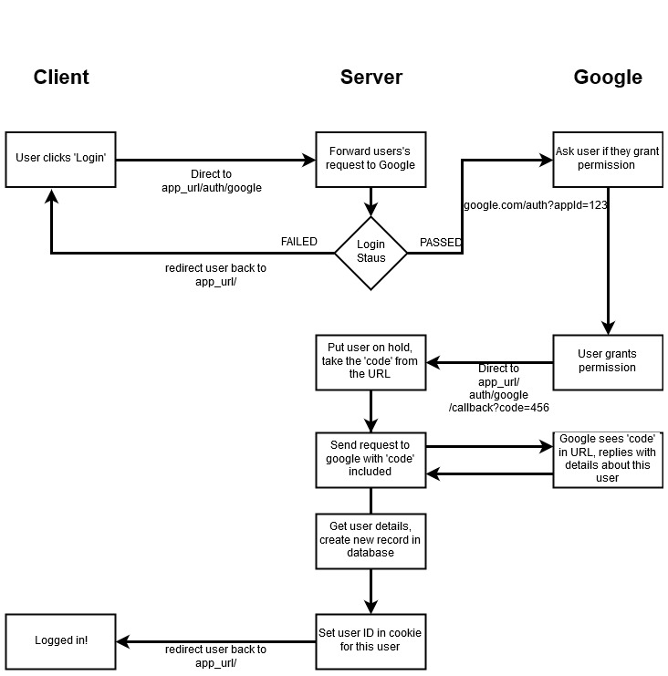
Google Oauth Flow Diagram

Slide 11
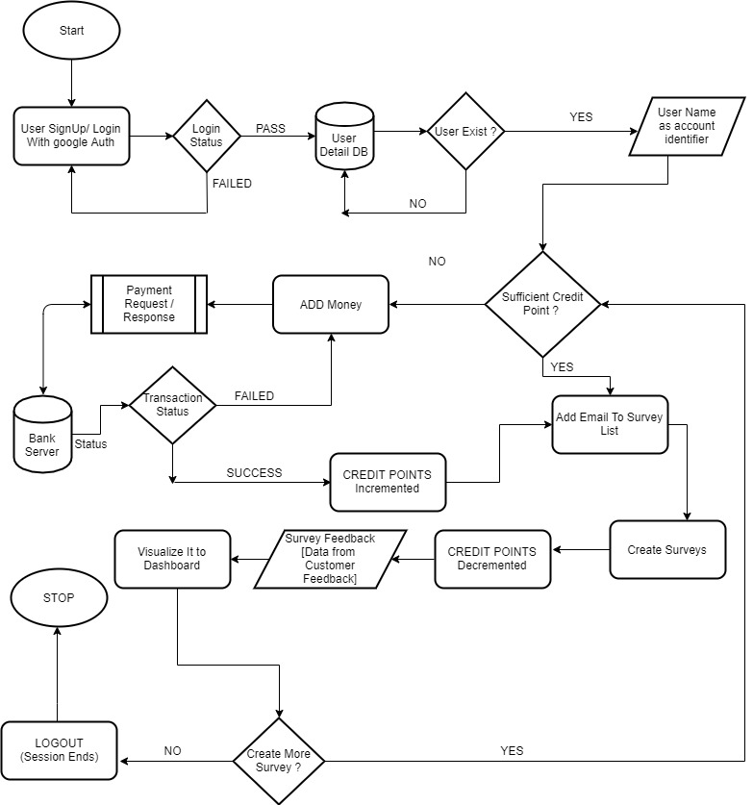
Flow Diagram Of System

Slide 12
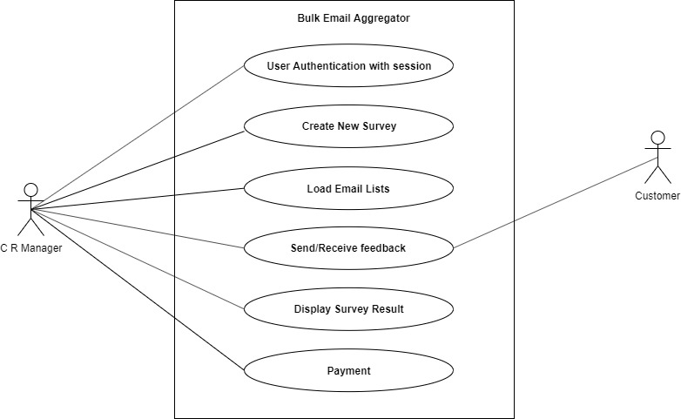
Use Case Diagram

Slide 13
Document Structure
"user":{
_id : ObjectId(""),
googleId : "String Type",
__v : "Integer Type",
credit : "Integer Type"
}
“feedback":{
_id: ObjectId(""),
yes: "Integer Type",
no : "Integer Type",
title : "String Type",
subject : "String Type",
body : "String Type",
recipients: "String Array Type" {
index : "Integer Type",
responded : "Boolean Type",
_id : ObjectId(""),
email : "String Type"
},
_user : ObjectId(""),
dateSent : "Date Time Type",
__v : “Integer Type”
}
"recipient" : {
email : "String Type",
responded : "Boolean Type"
}

Slide 14
Testing
Test Case ID |  | PES_001 | Test Case Description |  | Test the Login Functionality in login screen
Created By |  | Vijaykumar R Pai | Reviewed By |  | - |  |  | Version |  | 1
QA Tester’s Log
Tester's Name |  | Vijaykumar R Pai | Date Tested |  | 17-Nov-2019 |  |  | Test Case (Pass/Fail/Not Executed) |  | Pass
S # | Prerequisites: |  |  |  | S # | Test Data
1 | Access to Chrome Browser |  |  |  | 1 | E-mail = vijaykumarrpai@gmail.com
2 | https://sheltered-reef-50053.herokuapp.com/ |  |  |  | 2
3 |  |  |  |  | 3
4 |  |  |  |  | 4
Test Scenario | Verify on clicking Login With Google, the user logs into the application using his/her google account
Step # | Step Details |  | Expected Results |  | Actual Results |  |  |  |  |  | Pass / Fail / Not executed / Suspended
1 | Navigate to https://sheltered-reef-50053.herokuapp.com/ |  | Logged into application after clicking Login With Google |  | User is logged in |  |  |  |  |  | Pass
2 | Page displayed |  | Page should be redirected to https://sheltered-reef-50053.herokuapp.com/surveys |  | Home Page is displayed |  |  |  |  |  | Pass

Slide 15
Test Case ID |  | PES_002 | Test Case Description |  | Test the functionality of creating new feedback form with 0 credits
Created By |  | Vijaykumar R Pai | Reviewed By |  | - |  |  | Version |  | 1
QA Tester’s Log
Tester's Name |  | Vijaykumar R Pai | Date Tested |  | 17-Nov-2019 |  |  | Test Case (Pass/Fail/Not Executed) |  | Pass
S # | Prerequisites: |  |  |  | S # | Test Data
1 | Access to Chrome Browser |  |  |  | 1 | Campaign title - Test
2 | https://sheltered-reef-50053.herokuapp.com/ |  |  |  | 2 | Subject Line - Test
3 |  |  |  |  | 3 | Email Body – This is a test data
4 |  |  |  |  | 4 | Recipient list – vijaykumarrpai@gmail.com,........
 |  |  |  |  | 5
 |  |  |  |  | 6
Test Scenario | Creating new feedback form on clicking + button followed by entering the required details
Step # | Step Details |  | Expected Results |  | Actual Results |  |  |  |  |  | Pass / Fail / Not executed / Suspended
1 | Navigate to https://sheltered-reef-50053.herokuapp.com/surveys/new |  | Redirected to the feedback form creation page |  | Successfully redirected |  |  |  |  |  | Pass
2 | Enter Campaign Title, Subject Line, Email Body, Recipient List |  | Should redirect to next page on clicking next button |  | Successfully redirected |  |  |  |  |  | Pass
3 | Confirm the details and click on Send Feedback |  | Should successfully create new feedback form |  | Failed to create because there are no credits in the account |  |  |  |  |  | Fail

Slide 16
Test Case ID |  | PES_003 | Test Case Description |  | Test the functionality of creating new feedback form.
Created By |  | Vijaykumar R Pai | Reviewed By |  | - |  |  | Version |  | 1
QA Tester’s Log
Tester's Name |  | Vijaykumar R Pai | Date Tested |  | 17-Nov-2019 |  |  | Test Case (Pass/Fail/Not Executed) |  | Pass
S # | Prerequisites: |  |  |  | S # | Test Data
1 | Access to Chrome Browser |  |  |  | 1 | Campaign title - Test
2 | https://sheltered-reef-50053.herokuapp.com/ |  |  |  | 2 | Subject Line - Test
3 |  |  |  |  | 3 | Email Body – This is a test data
 |  |  |  |  | 4 | Recipient list – vijaykumarrpai@gmail.com,........
Test Scenario | Creating new feedback form on clicking + button followed by entering the required details
Step # | Step Details |  | Expected Results |  | Actual Results |  |  |  |  |  | Pass / Fail / Not executed / Suspended
1 | Navigate to https://sheltered-reef-50053.herokuapp.com/surveys/new |  | Redirected to the feedback form creation page |  | Successfully redirected |  |  |  |  |  | Pass
2 | Enter Campaign Title, Subject Line, Email Body, Recipient List |  | Should redirect to next page on clicking next button |  | Successfully redirected |  |  |  |  |  | Pass
3 | Confirm the details and click on Send Feedback |  | Should successfully create new feedback form |  | Successfully created new feedback and sent to the entered email id |  |  |  |  |  | Pass

Slide 17
Test Case ID |  | PES_004 | Test Case Description |  | Test the functionality of creating new feedback form.
Created By |  | Vijaykumar R Pai | Reviewed By |  | - |  |  | Version |  | 1
QA Tester’s Log
Tester's Name |  | Vijaykumar R Pai | Date Tested |  | 17-Nov-2019 |  |  | Test Case (Pass/Fail/Not Executed) |  | Pass
S # | Prerequisites: |  |  |  | S # | Test Data
1 | Access to Chrome Browser |  |  |  | 1 | Campaign title -
2 | https://sheltered-reef-50053.herokuapp.com/ |  |  |  | 2 | Subject Line -
3 |  |  |  |  | 3 | Email Body –
 |  |  |  |  | 4 | Recipient list –
Test Scenario | Creating new feedback form on clicking + button followed by entering the required details
Step # | Step Details |  | Expected Results |  | Actual Results |  |  |  |  |  | Pass / Fail / Not executed / Suspended
1 | Navigate to https://sheltered-reef-50053.herokuapp.com/surveys/new |  | Redirected to the feedback form creation page |  | Successfully redirected |  |  |  |  |  | Pass
2 | Did not fill any field |  | Should say ‘You must provide a value’ |  | Says ‘You must provide a value’ |  |  |  |  |  | Pass
3 | Click Next |  | Should not go to review page |  | Did not redirect to review page |  |  |  |  |  | Pass

Slide 18
Test Case ID |  | PES_005 | Test Case Description |  | Adding Credits through Stripe Gateway
Created By |  | Vijaykumar R Pai | Reviewed By |  | - |  |  | Version |  | 1
QA Tester’s Log
Tester's Name |  | Vijaykumar R Pai | Date Tested |  | 17-Nov-2019 |  |  | Test Case (Pass/Fail/Not Executed) |  | Pass
S # | Prerequisites: |  |  |  | S # | Test Data
1 | Access to Chrome Browser |  |  |  | 1 | Email – wdawda@awdawd.com
2 | https://sheltered-reef-50053.herokuapp.com/ |  |  |  | 2 | Card number – **** **** **** ****
3 |  |  |  |  | 3 | Expiry date – 09/20
 |  |  |  |  | 4 | CVC - 123
Test Scenario | Adding credits by clicking on Add Credits
Step # | Step Details |  | Expected Results |  | Actual Results |  |  |  |  |  | Pass / Fail / Not executed / Suspended
1 | Navigate to https://sheltered-reef-50053.herokuapp.com/surveys |  | Should redirect successfully |  | Redirected successfully |  |  |  |  |  | Pass
2 | Click on ‘Add Credits’ |  | Should ask to enter card details |  | Opened card details page |  |  |  |  |  | Pass
3 | Enter email, card no, expiry month and year and CVC |  | Enter details |  | Entered details |  |  |  |  |  | Pass
4 | Click on Pay |  | Should increment credits |  | Credits incremented |  |  |  |  |  | Pass

Slide 19
Test Case ID |  | PES_006 | Test Case Description |  | Adding Credits through Stripe gateway without entering card details
Created By |  | Vijaykumar R Pai | Reviewed By |  | - |  | Version |  | 1
QA Tester’s Log
Tester's Name |  | Vijaykumar R Pai | Date Tested |  | 17-Nov-2019 |  | Test Case (Pass/Fail/Not Executed) |  | Pass
S # | Prerequisites: |  |  |  | S # | Test Data
1 | Access to Chrome Browser |  |  |  | 1 | Email – wdawda@awdawd.com
2 | https://sheltered-reef-50053.herokuapp.com/ |  |  |  | 2 | Card number – **** **** **** ****
3 |  |  |  |  | 3 | Expiry date – 09/20
4 |  |  |  |  | 4 | CVC - 123
Test Scenario | Adding credits by clicking on Add Credits
Step # | Step Details |  | Expected Results |  | Actual Results |  |  | Pass / Fail / Not executed / Suspended
1 | Navigate to https://sheltered-reef-50053.herokuapp.com/surveys |  | Should redirect successfully |  | Redirected successfully |  |  | Pass
2 | Click on ‘Add Credits’ |  | Should ask to enter card details |  | Opened card details page |  |  | Pass
3 | Did not enter email, card no, expiry month and year and CVC |  | Details not entered |  | Details not entered |  |  | Pass
4 | Click on Pay |  | Should not do any transaction and credit will not be incremented |  | Did not do any transaction and credit not incremented |  |  | Pass

Slide 20
Test Case ID |  | PES_007 | Test Case Description |  | Testing Logout functionality
Created By |  | Vijaykumar R Pai | Reviewed By |  | - |  | Version |  | 1
QA Tester’s Log
Tester's Name |  | Vijaykumar R Pai | Date Tested |  | 17-Nov-2019 |  | Test Case (Pass/Fail/Not Executed) |  | Pass
S # | Prerequisites: |  |  |  | S # | Test Data
1 | Access to Chrome Browser |  |  |  | 1
2 | https://sheltered-reef-50053.herokuapp.com/surveys |  |  |  | 2
3 |  |  |  |  | 3
4 |  |  |  |  | 4
5 |  |  |  |  | 5
6 |  |  |  |  | 6
Test Scenario | Verify on clicking logout button, the user is logged out
Step # | Step Details |  | Expected Results |  | Actual Results |  |  | Pass / Fail / Not executed / Suspended
1 | Navigate to https://sheltered-reef-50053.herokuapp.com/surveys |  | Should redirect successfully |  | Redirected successfully |  |  | Pass
2 | Click on ‘Logout’ button |  | Should logout out of the application |  | Successfully logged out of the application |  |  | Pass

Slide 21
Test Case ID |  | PES_008 | Test Case Description |  | Testing by responding to feedback form received
Created By |  | Vijaykumar R Pai | Reviewed By |  | - |  | Version |  | 1
QA Tester’s Log
Tester's Name |  | Vijaykumar R Pai | Date Tested |  | 17-Nov-2019 |  | Test Case (Pass/Fail/Not Executed) |  | Pass
S # | Prerequisites: |  |  |  | S # | Test Data
1 | Access to Chrome Browser |  |  |  | 1 | E-mail id = vijay@gmail.com
2 | Log into your registered email account |  |  |  | 2 | Pass = dawdawd
3 |  |  |  |  | 3
4 |  |  |  |  | 4
Test Scenario | Verify while responding to the feedback, the response is recorded
Step # | Step Details |  | Expected Results |  | Actual Results |  |  | Pass / Fail / Not executed / Suspended
1 | Navigate to Gmail account |  | Logged into account |  | Logged into account |  |  | Pass
2 | Respond to received feedback form |  | Should able to click yes or no |  | Response recorded |  |  | Pass
3 | Redirected to page saying ‘thank you for voting’ |  | Redirect to the message page |  | Redirected to the message page successfully |  |  | Pass

Slide 22
Conclusion
The objective of the project was to solve the difficulties faced by the CRM’s who have to send individual emails to each customer who purchase products from different electronic companies, which has been solved with our application as it provides a paid service to end users which will enable them to send bulk emails for collecting feedback of their own electronic products once they complete transaction through Stripe payment gateway. Our service will be provided on usage of assigned credit points to user. So once the CRM who will be using the application does payment, 5 credit points will be incremented to the user’s account and he can send emails with this credit. Since our application is built with React.js, it is lightweight, responsive, loads faster once it will be deployed. In addition, the whole application has been deployed on Heroku platform. So in the future, if the user requests for any changes, it can be easily done through git version control. Hence, the objective has been fulfilled and application provides bulk email delivery.

Slide 23
Future Enhancement
Lot of features and functionalities can be integrated in our project. Firstly, we can group certain customers into one batch so that we can send bulk emails in one shot.
Secondly, we can build a customized Android app using Android Studio or React Native which will make user more convenient to use.

Slide 24
Bibliography
https://www.coursera.com/
https://reactjs.org/tutorial/tutorial.html
https://www.w3schools.com/react/
https://www.npmjs.com/
https://developers.google.com/identity/protocols/OAuth2
https://stripe.com/docs/api
https://devcenter.heroku.com/categories/nodejs-support
https://sendgrid.com/docs/for-developers/
https://www.edx.org/
https://docs.mongodb.com/cloud/

Slide 25
HERE the live deployment of Web App
https://sheltered-reef-50053.herokuapp.com

Slide 26
THANK YOU

